Slide 1

OMNI_RAG
CS5004
FINAL PROJECT
Professor: Dr. Rached Zantout
Nguyen "John" Ha
Rui "Snow" Song
Siyuan "Ash" Liang
https://github.com/johnha912/rag-core-engine
Notes:
John: Before we get started, you guys can clone the app repo to your computer for experience, we also leave the instructions how to use there in both terminal and app.
Snow
Hi everyone, we're Team OmniRAG. I'm Snow, that's John, and that's Ash. Today we're presenting our final project — a full Retrieval-Augmented Generation engine built in Java 21 and Spring Boot. Let's get right into it.

Slide 2

INTRODUCTION
The Omni RAG Core Engine is a Java 21 and Spring Boot-based system that transforms diverse documents into a searchable knowledge base, providing hallucination-free AI answers with precise citations.
OBJECTIVES
DESIGN GOAL
APPLICATION
Build a robust RAG engine using modern Java 21 & Spring Boot. Enable seamless document uploads and natural language querying with verifiable source citations.
Deliver hallucination-free "open-book" answers. Utilize domain-aware chunking (scripts by scenes, legal by clauses) combined with semantic vector search.
Functions as an accurate knowledge base for specialized fields: film production documents, legal texts, and structured technical documentation.
Notes:
Snow
So what is OmniRAG?
it's an open-book AI system — instead of asking an LLM to answer from memory and risk hallucinating, we first retrieve the most relevant passages from your document, then ask the model to answer based only on that evidence, with citations.
We built it across three domains — film production, legal texts, and technical documentation. These aren't random choices: they're format-diverse and each requires domain-specific parsing - a wrong answer about a legal clause matters. So accuracy and citation are non-negotiable.

Slide 3

TECHNICAL STACK
CORE FRAMEWORK
Java 21 | Spring Boot 3.2.5 (Web + Actuator)
Maven 3.9+ (Build)
OkHttp 4.12.0 (30s/120s timeouts)
Gson 2.10.1 (JSON + SSE encoding)
STORAGE
SQLite JDBC 3.45.3.0 (Vector BLOB Storage)
CopyOnWriteArrayList (In-Memory Fallback)
ConcurrentHashMap (Embedding Cache)
AI MODELS
OpenAI GPT-4o-mini (Gen + Re-ranker)
OpenAI text-embedding-3-small (1536-dim)
Cosine Similarity (Hand-implemented)
PARSING & EXTRACTION
PDFBox (.pdf) | POI (.docx) | Jsoup (.html)
Java Adapters: .txt, .md, .csv, .json, .vtt, .srt, .fdx
TESTING
JUnit 5.10.0 + Spring Boot Test
Notes:
Snow
The system is built on Java 21, Spring Boot 3.2.5,
OpenAI's text-embedding-3-small for vectorization
gpt-4o-mini for generation and re-ranking.
Ash will now show you how it actually works.

Slide 4
LIVE OPERATION
Upload, Index, and Query
 | Upload .pdf/.md/.srt/e.g. |  |  | Real-time vector indexing |  |  | Ask question within server-sent events streaming answers
Notes:
Ash
Thanks Snow. Let me walk you through the system — from the user's perspective, and then behind the scenes
**From the user side**, it's three steps: Upload, Index, Query.
You drop in a file — lets say, a screenplay PDF — the system chunks and vectorizes it in the background, and then you ask it anything in English. The answer streams back token by token in real time through Server-Sent Events, so it feels live.

Slide 5

LIVE OPERATION
01
User Input
Upload & Query: RagController REST API
02
Orchestration
Pipeline Coordinator: RagOrchestrator
03
Extraction
Document Parsing: DocumentAdapter
04
Vectorization
EmbeddingServiceImpl - Text to float arrays
05
Storage
SQLiteVectorStore: Cosine similarity search
06
Output
LlmReranker & ChatService: Refines Top-10 to Top-5, then Answers with citations
Notes:
Ash
**Now let me trace exactly what happens internally** when you hit query.
Step 1 — your request lands on `RagController`
Step 2 — it hands off to `RagOrchestrator奥克丝吹特`, the central coordinator.
Step 3 — the document was already parsed by a `DocumentAdapter` during upload.
Step 4 — each chunk was embedded into a 1,536-dimensional float array and stored in `SQLiteVectorStore`.
Step 5 — on query, we retrieve瑞吹唔 the top 10 similar chunks using **hand-implemented cosine similarity** — dot product over the product of magnitudes
Step 6 — those 10 chunks go through `LlmReranker`, which makes one GPT-4o-mini call to pick the best 5, and then `ChatService` generates the final answer with source citations.

Slide 6

ARCHITECTURE
HTTP Client / Browser
Spring Boot REST Layer
/api/upload | /api/query | /api/stream
/api/reset | /api/status | /api/eval
RagOrchestrator
index flow / query flow
DocumentAdapter
(parse + chunk)
VectorStore
(embed + store + search)
ChatService
(GPT-4o-mini)
LlmReranker
(re-rank top-10 → top-5)
Index flow: upload → DocumentAdapter (parse + chunk) → VectorStore (embed + store)
Query flow: question → VectorStore (search top-10) → LlmReranker (re-rank → top-5) → ChatService (generate) → answer + sources
Notes:
Ash
For the architecture, we have an HTTP client at the top, then a Spring Boot REST layer with six endpoints. Everything goes through the orchestrator, which then hands things off to the DocumentAdapter, VectorStore, and ChatService. The orchestrator only talks to interfaces.

Slide 7

THE ABSTRACTION
Orchestrator's Reality
Implementation "Noise"
The coordinator operates in a "pure" domain. It has no idea OpenAI or SQLite exist.
embeddingService.embed(text)
Input: Raw String → Output: Vector
vectorStore.search(query, topK)
Input: Vector → Output: List<Document>
Hidden beneath the interfaces is the messy infrastructure:
OkHttp 4.12.0: Network retries & TLS
Gson: parsing choices[0].delta
SQLite JDBC: Batch inserts & WAL
Math: cos() = (A B) / (|A||B|)
The orchestrator only knows about text and vectors.
Notes:
Ash
Left side — orchestrator's world: embed(text) gives a vector, search(query, topK) gives documents. That's all it knows.
Right side — the hidden mess: OkHttp, Gson, SQLite, cosine math. Orchestrator never touches any of it. That's coding to an interface. And in the end we got 94% retrieval hit rate.
John will walk us through a live demo.

Slide 8
API WORKFLOW & CAPABILITIES
01. INGESTION & DOMAIN BINDING
POST /api/upload [file: screenplay.pdf, domain: film script]
Response: { name: "screenplay.pdf", chunks: 142 }
Batch-embedded: 142 chunks in 2 OpenAI calls (sub-batched @100, cache-aware)
05. EVALUATION ENDPOINT
POST /api/eval { retrieval_hit_rate: 0.94, keyword_accuracy: 0.88 }
06. STREAMING ANSWERS
GET /api/stream?question=... event: "The" ... event: [DONE]
Tokens encoded with Gson safe for every control character.
02. SEMANTIC QUERY
POST /api/query ["What happens in the second act?"]
Answer: "The protagonist encounters..."
03. MULTI-TURN RESOLUTION
Follow-up: "Tell me more about that scene."
System resolves "that scene" to Scene 12 using memory history.
ENGINEERING STACK
Framework: Spring Boot 3.2, Java 21
Intelligence: GPT-4o-mini, text-embedding-3 (batch API)
Storage: SQLite via JDBC
Parsing: PDFBox, POI, Jsoup, Gson
Client: OkHttp 4.12 (30s/120s/30s timeouts)
Testing: JUnit 5, Spring Test
04. DOMAIN HOT-SWAP
DELETE /api/reset POST /api/upload [lease.pdf]
Query: "Heater broken?" Persona: Legal Assistant
Notes:
John after showing demo
Upload with domain binding,
semantic query with citations,
multi-turn follow-ups,
domain hot-swap.
Built-in eval endpoint for retrieval metrics.
All answers stream via SSE, safely encoded.

Slide 9
Project Core
Code Walkthrough

Slide 10
PATTERNS
Inheritance & Template Method
Interface & Polymorphism
BaseDocumentAdapter handles parsing logic for PDF, DOCX, and MD once.
Subclasses focus only on buildChunks():
ScriptAdapter: Scene-boundary splitting
RentalLawAdapter: Section-number splitting
GeneralAdapter: Fixed-size w/ overlap
VectorStore interface decouples the core logic from storage details.
@Primary SQLiteVectorStore
Persistent storage is swapped in for InMemoryVectorStore with zero code changes in the Orchestrator.
Notes:
John
Template Method: BaseDocumentAdapter handles shared parsing, subclasses only override buildChunks() — scenes for scripts, sections for legal, fixed-size for general.
Interface polymorphism: VectorStore interface, SQLiteVectorStore tagged @Primary. Switch to in-memory? Zero orchestrator changes.

Slide 11
OmniRAG LIMITATIONS
01. FILE SIZE CAPACITY
max-file-size: 50MB
Hard cap configured in application properties. Requests exceeding 50MB are rejected at network layer.
02. ACCEPTED FORMATS
PDF, DOCX, MD, SRT, VTT, TXT, HTML, CSV, JSON, FDX
Strict whitelist; unsupported types trigger 400 IllegalArgumentException.
03. EMBEDDING LIMITS
Batch: 300,000 Tokens
Groups of 100 chunks must stay under OpenAI's 300k limit. Minimal risk for standard chunking.
04. AUTH & RATE LIMITING
No login, no rate limits, no per-user quotas. Accessible for anonymous query/upload.
Design Priority: Open Access > Security
05. SERVER ENVIRONMENT
JDK 21 permanently added to replit.nix to mitigate Maven reset issues.
replit.nix: pkgs.jdk21, pkgs.maven
Notes:
John
50MB file cap. Strict format whitelist. 300K token embedding limit. No auth or rate limiting — open access for demo purposes.

Slide 12

REFLECTIONS & CONCLUSIONS
The "Invisible" Mutation Bug
Mutating defensive copies of metadata. chunk.getMetadata().put("domain", val)
Result: Domain was never saved.
The Fix: Dedicated write path. Reinforced encapsulation.
The Reinvented-Wheel Bug
Hand-rolled JSON escaping for control chars \u0000–\u001F crashed parser.
The Fix: gson.toJson(token). Don't reimplement a library's spec.
The Interface Payoff
Freezing VectorStore enabled parallel dev. SQLite swap in Wk 3 required zero changes. EmbeddingService evolved via default methods without breaking callers.
Full-Spectrum Application
Interfaces & Polymorphism
Default Methods & Evolution
Inheritance & Template Method
Encapsulation & DI
LESSON: Controllers handle transport, not serialization. OOD decoupling pays off.
Notes:
Snow We hit two bugs that taught us the most.
The first one — the Invisible Mutation Bug.
Domain stamping wasn't working, every document was defaulting to "general" no matter what we uploaded. Turns out, getMetadata() returns a defensive copy — The data was never saved! We added a dedicated putMetadata() method directly on the Chunk class to fix this. Lesson: encapsulation has real consequences. If we want something to be immutable, make sure we also provide a write path.
The second one is SSE Crash Bug. Our streaming endpoint was hand-rolling JSON escaping — we thought we'd covered it, handled three control characters. Then GPT-4o-mini returned a Unicode null byte, and the client just crashed. The fix was literally one line: gson.toJson(token).
We started week one with a basic in-memory loop. We ended with SQLite persistence, LLM re-ranking, batch embedding.
More importantly, every major OOD concept from this course is present in this codebase as a real architectural decision. The VectorStore interface we froze on Day 1 let all three of us develop in parallel without merge conflicts. When SQLite was added, the Orchestrator didn't change. When batch embedding was added, existing callers kept working.

Slide 13
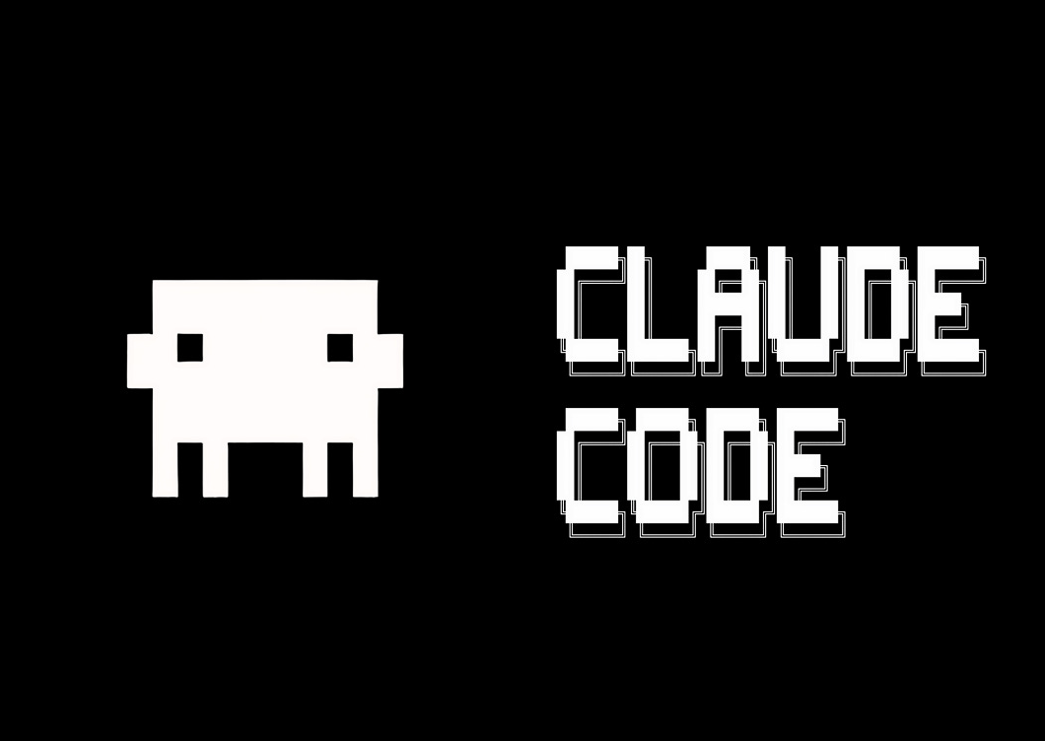
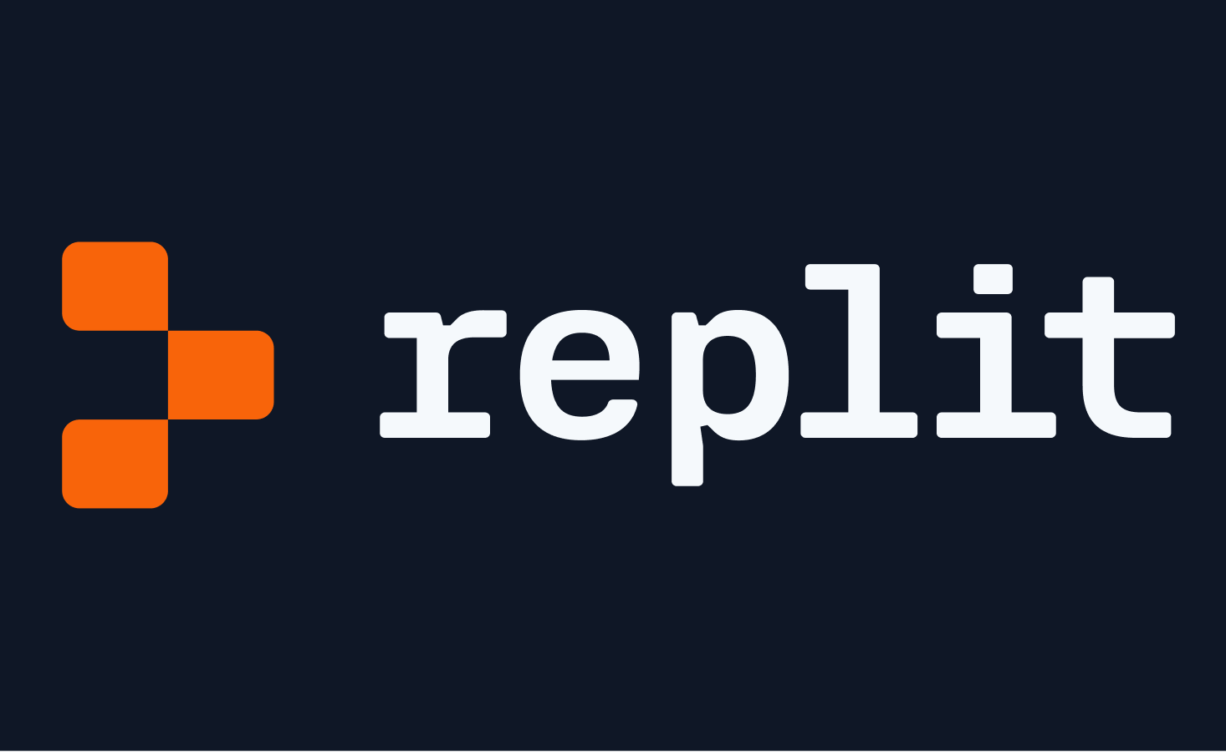
THANK
YOU!
Lewis et al. (2020). Retrieval-Augmented Generation for Knowledge-Intensive NLP Tasks. NeurIPS 2020. https://arxiv.org/abs/2005.11401
OpenAI. (2024). Embeddings API — text-embedding-3-small. https://platform.openai.com/docs/guides/embeddings
Spring Framework. (2024). Spring Boot Reference Documentation. https://docs.spring.io/spring-boot/docs/current/reference/html/

